Slide 1

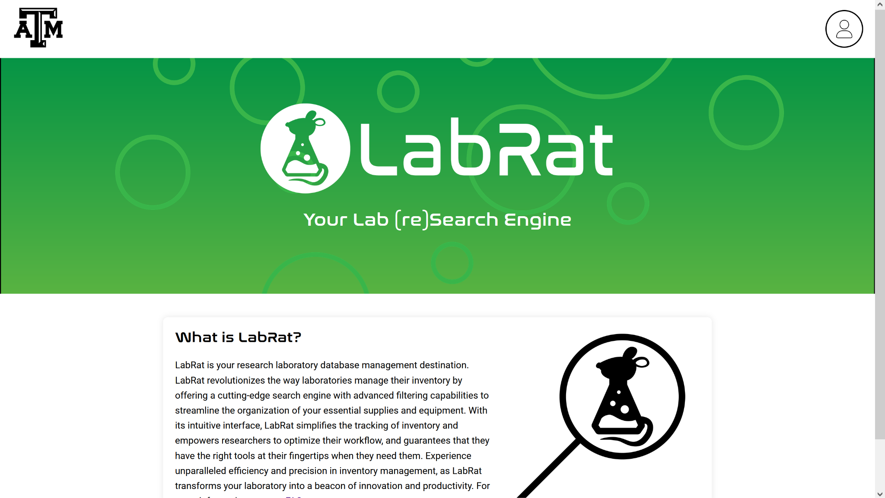
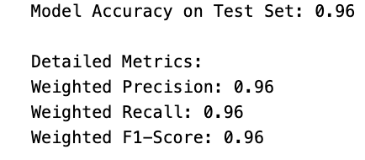
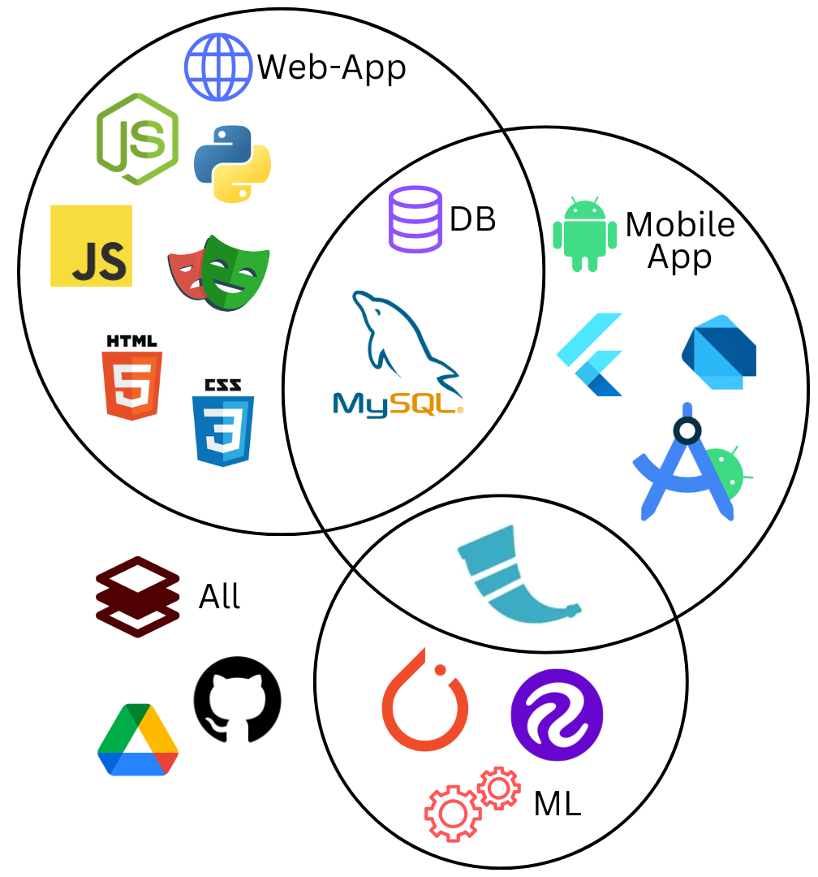
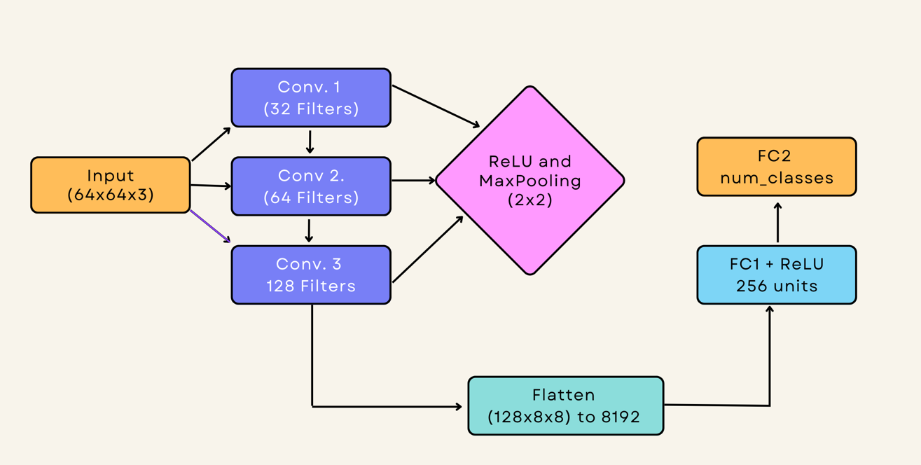
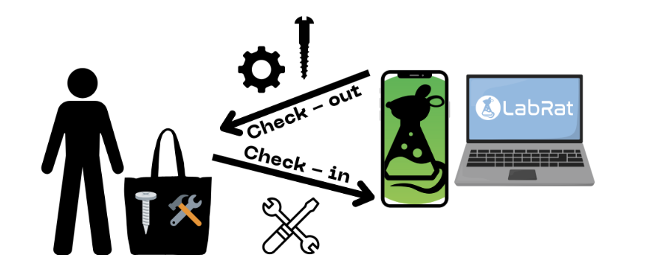
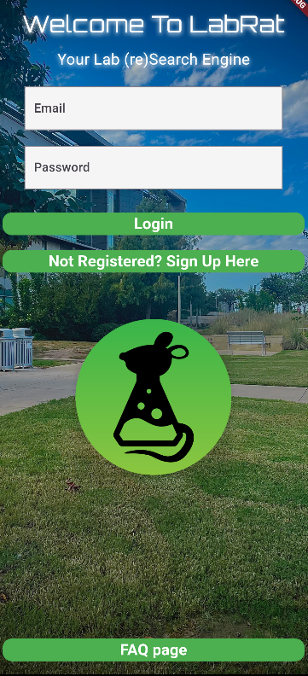
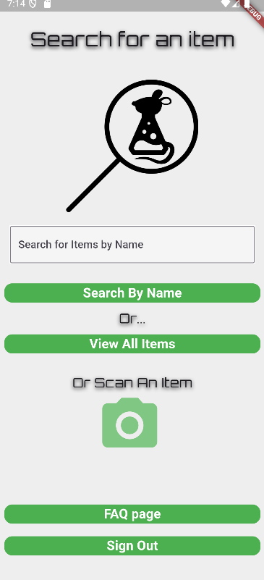
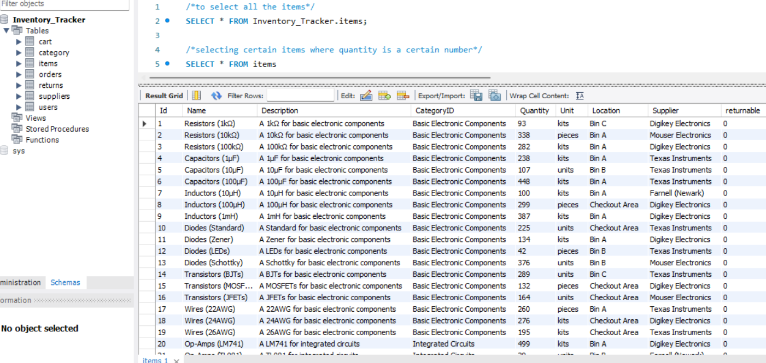
Booth Number: 334
Lab Research Inventory Manager - LabRat
Lizzett Tapia, Sumedha Bhattacharyaa, Jonathan Moore, and Evan Ross
Faculty Mentor: Prasad Enjeti
Problem Definition
The current lab inventory tracking systems at Texas A&M are inefficient, and it is necessary to create new, organized software to increase the overall performance and efficiency of the Lab.
Engineering Analysis
We designed a multi-subsystem solution consisting of a MYSQL database hosted through AWS, a web-based dashboard, a mobile application, and a machine learning model for image classification.
Key tasks and tests completed:
Database Design: Created relational database tables for data consistency.
Mobile App and Website Design: Created a Mobile App and Website for users to easily check in/out items and improve inventory tracking.
ML Model Design: Designed an image classification model.
System Integration: Linked the mobile app and website to the hosted MySQL backend, supporting real-time updates. Linked the ML Model to the App via a local server.
Table 1. ML Model Metrics
Methodology
We developed a website and mobile application, both of which are integrated with a database to streamline inventory management in TAMU labs. The mobile app uses a machine learning-based image classification system to allow users to easily check items in and out by scanning them.
Our Tech-Stack:
Web-App: Node.js, Python, HTML/CSS/Javascript, Playwright Mobile App: Android Studio, Flutter, Dart, Flask Database: MySQL Machine Learning: Pytorch, Roboflow, Flask
Outcomes
We achieved a real-time lab inventory tracker between all four subsystems. The image classification model performed well with over 95% accuracy, significantly reducing human input during item check-in/check-out. All Create, Read, Update, and Delete (CRUD) actions performed reliably across the website and mobile app, with real-time sync and zero data inconsistencies. Deploying the website and mobile app has improved efficiency metrics, such as reduced average item check-in/out time from 3 minutes (manual) to 1 sec (automated).
Figure 4. UI of Website
Impact
LabRat helped reduce the time spent manually tracking and logging items across multiple A&M labs. It allows for real-time visibility for staff and students to instantly see current inventory status from any device. By linking user actions to item check-outs, the system improved item return rates and accountability. In addition, the architecture can be easily expanded to support additional lab facilities or research groups.
neque dignissim, and in aliquet nisl et umis.
Figure 2. Comprehensive Model Architecture Diagram
Figure 4. Project Visualization
References
Google’s Machine Learning Crash Course. Google Machine Learning Education, 2023.
Building a Python Image Recognition System. Cloudinary, 2024.
OpenCV Library (v 4.10.0). OpenCV.
Flutter document. Flutter, 2017.
Figure 1: Venn diagram of all software we used in development
Acknowledgements
Thank you to our TAs/Sponsors Shima Hasanpour & Niloofar Borzooei
Figure 3. Items database table in MySQL Workbench
Figure 4. UI of Mobile App

